Slide 1

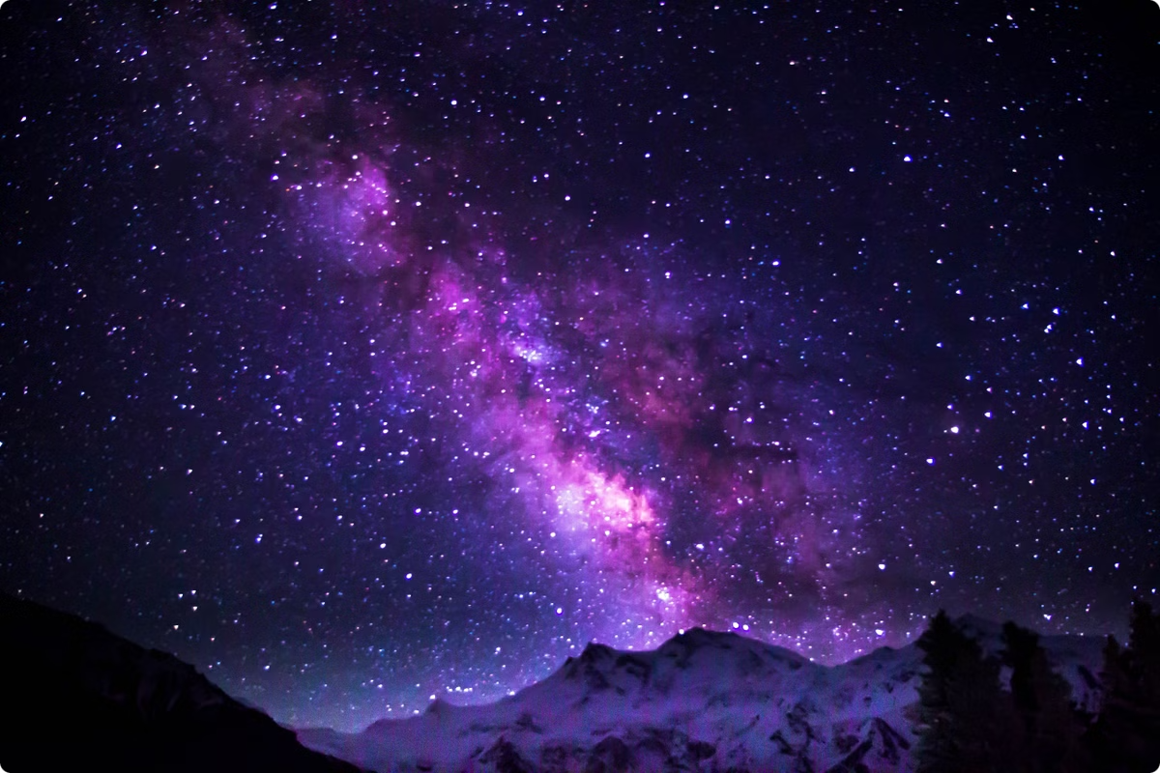

Celestio: Your Window to the Cosmos
Explore the universe, from planets to asteroids.
by CELESTIAL MINDS 🧠✨

Slide 2

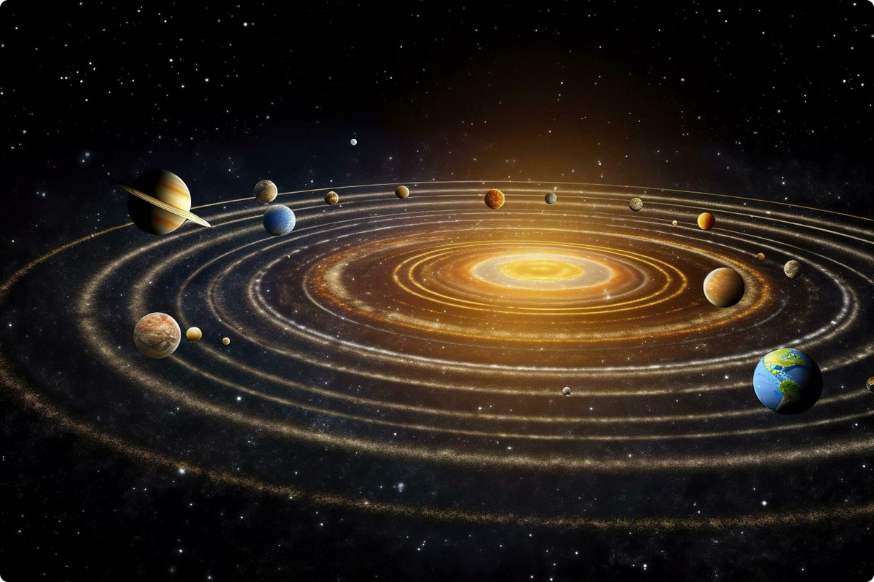
Exploring the Solar System and Beyond
1
Planets
2
Asteroids
Mercury to Neptune, detailed information.
Near-Earth objects and their orbits.
3
Comets
Icy bodies from the outer solar system.

Slide 3

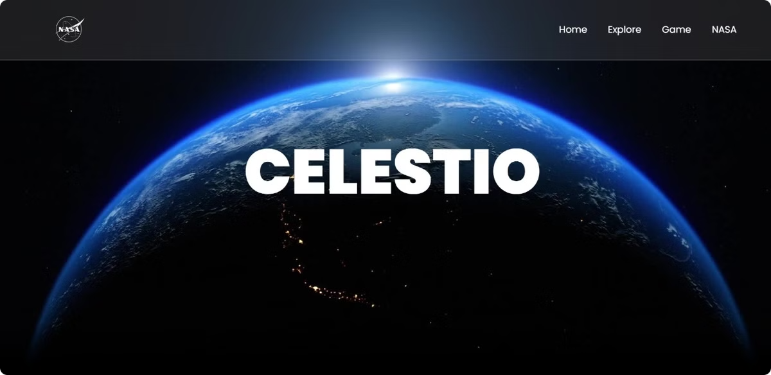
Celestio's User-Friendly Orrery
Easy navigation and control for all users.
Zoom, rotate, and explore the celestial bodies.
Comprehensive details on each celestial object.

Slide 4

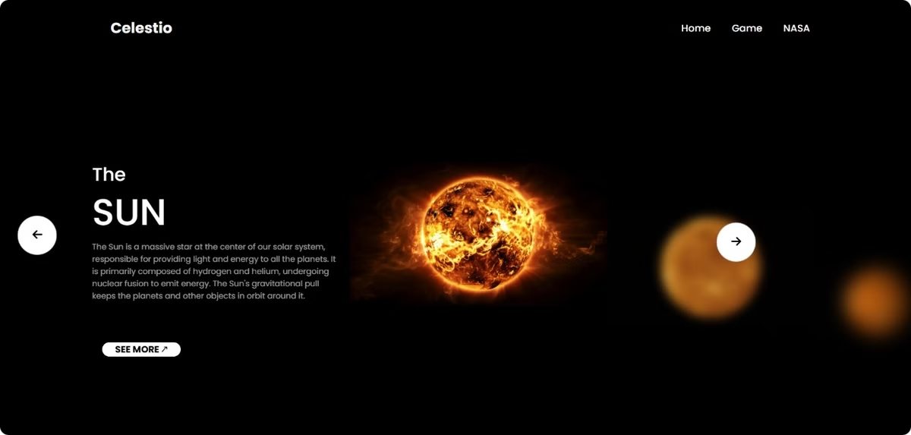
Celestial Body Visualization

Slide 5

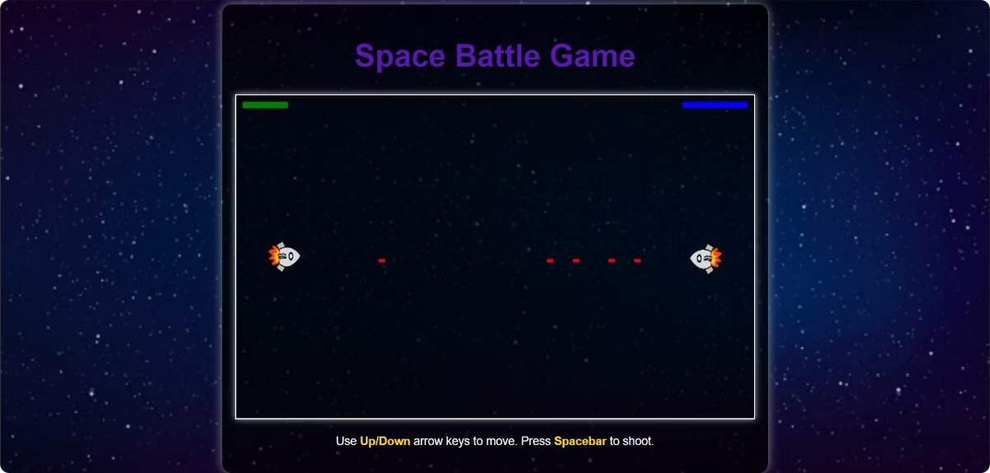
Engaging Educational Games
Space Battle Game
Players battle against AI opponents, fostering critical thinking and decision-making abilities in a fun and interactive environment

Slide 6

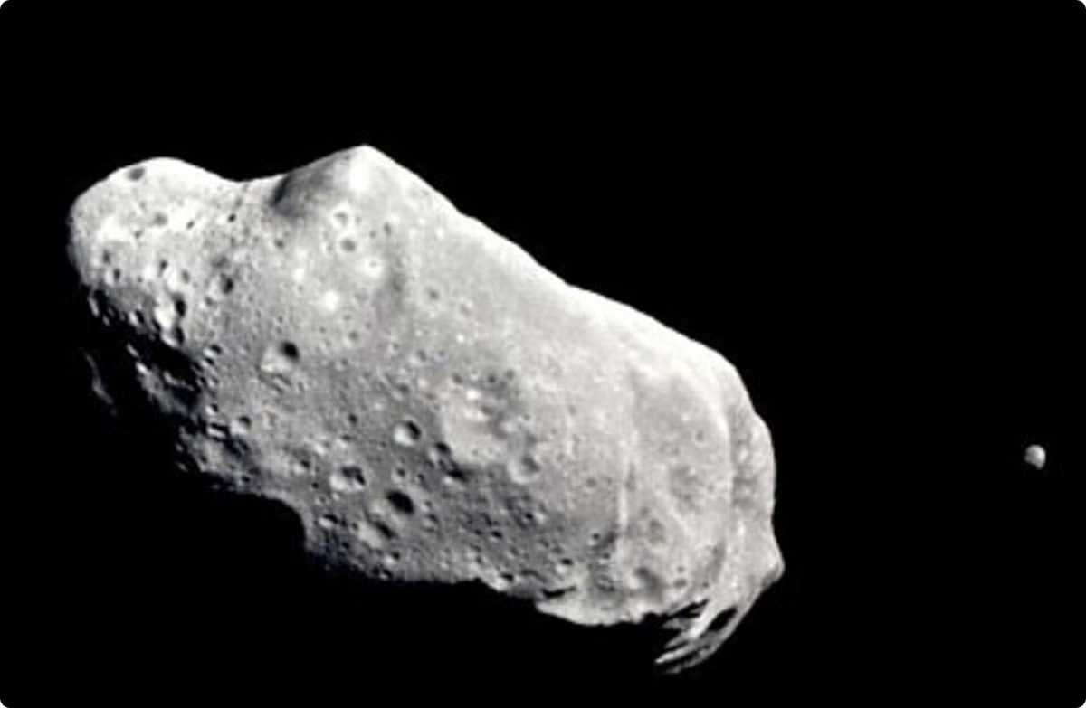
Monitoring Near-Earth Objects
Near-Earth Asteroids
Near-Earth Comets
Potentially Hazardous Asteroids
Tracked and monitored for potential impact.
Observed for their orbital paths and effects.
High-risk objects requiring close attention.

Slide 7


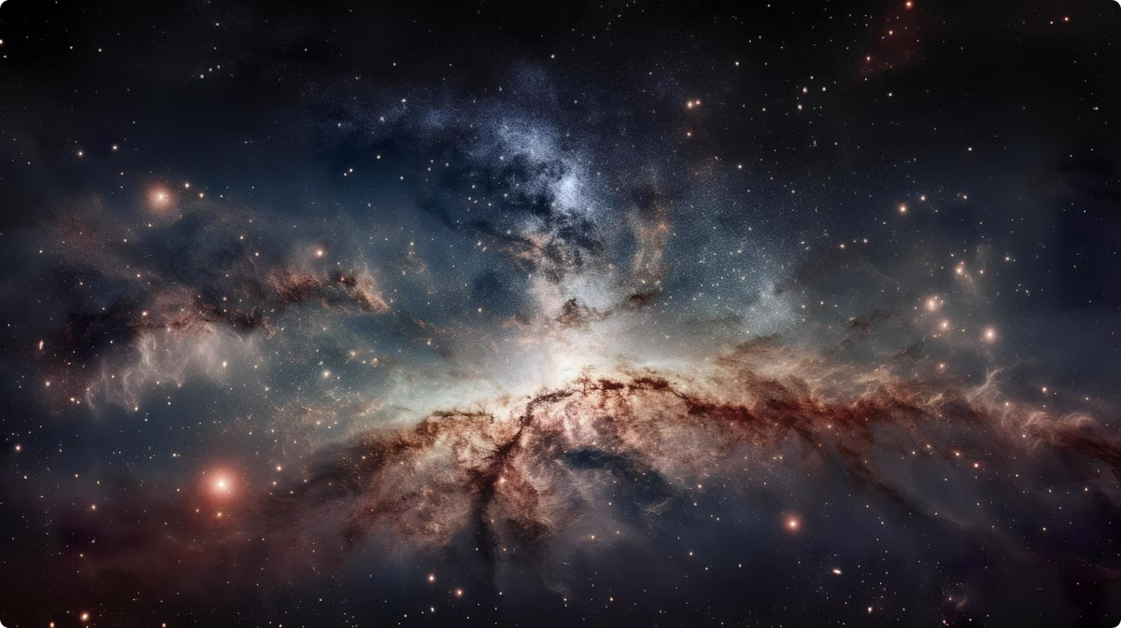


Empowering Users to Discover the Cosmos
Accessibility
Democratizing access to astronomical knowledge.
Exploration
Inspiring curiosity and fostering a love for space.
Learning
Providing an engaging and interactive learning experience.

